Slide 1

#LifeKoKaroLift
Advanced Regression & Model selection

Slide 2



Lecture On : Advanced Regression and Model selection
Instructor : Thulasiram

Slide 3
FLOW
Demo of Advanced regression
Why Regularization
L1 and L2 Regularization
Robust Regression
Conclusion
ElasticNet

Slide 4




Poll 1
In a linear regression problem, we are using “R-squared” to measure goodness-of-fit. We add a feature in linear regression model and retrain the same model.
Which of the following option is true?
A. If R Squared increases, this variable is significant.
B. If R Squared decreases, this variable is not significant.
C. Individually R squared cannot tell about variable importance. We can’t say anything about it right now.
D. None of these.
Practice in teams of 4 students
Industry expert mentoring to learn better
Get personalised feedback for improvements
29-06-2019
11

Slide 5
Solution: C
“R squared” individually can’t tell whether a variable is significant or not because each time when we add a feature, “R squared” can either increase or stay constant. But, it is not true in case of “Adjusted R squared” (increases when features found to be significant).
Poll 1(Answer)
Practice in teams of 4 students
Industry expert mentoring to learn better
Get personalised feedback for improvements
29-06-2019
11

Slide 6
Poll 2
Suppose we have generated the data with help of polynomial regression of degree 3 (degree 3 will perfectly fit this data). Now consider below points and choose the option based on these points.
Simple Linear regression will have high bias and low variance
Simple Linear regression will have low bias and high variance
polynomial of degree 3 will have low bias and high variance
Polynomial of degree 3 will have low bias and Low variance
A. Only 1
B. 1 and 3
C. 1 and 4
D. 2 and 4
Practice in teams of 4 students
Industry expert mentoring to learn better
Get personalised feedback for improvements
29-06-2019
11

Slide 7
Poll 2(Answer)
Solution: C
If we fit higher degree polynomial greater than 3, it will overfit the data because model will become more complex. If we fit the lower degree polynomial less than 3 which means that we have less complex model so in this case high bias and low variance. But in case of degree 3 polynomial it will have low bias and low variance.
Practice in teams of 4 students
Industry expert mentoring to learn better
Get personalised feedback for improvements
29-06-2019
11

Slide 8
Poll 3
Suppose you have fitted a complex regression model on a dataset. Now, you are using Ridge regression with tuning parameter lambda to reduce its complexity. Choose the option(s) below which describes relationship of bias and variance with lambda.
A. In case of very large lambda; bias is low, variance is low
B. In case of very large lambda; bias is low, variance is high
C. In case of very large lambda; bias is high, variance is low
D. In case of very large lambda; bias is high, variance is high
Practice in teams of 4 students
Industry expert mentoring to learn better
Get personalised feedback for improvements
29-06-2019
11

Slide 9
Poll 3(Answer)
Solution: C
If lambda is very large it means model is less complex. So in this case bias is high and variance in low.
Practice in teams of 4 students
Industry expert mentoring to learn better
Get personalised feedback for improvements
29-06-2019
11

Slide 10
‘If you are using regression without regularization, you have to be very special!’
- Owen Zhang, Chief Product Officer (DataRobot)

Slide 11
Why Regularization

Slide 12
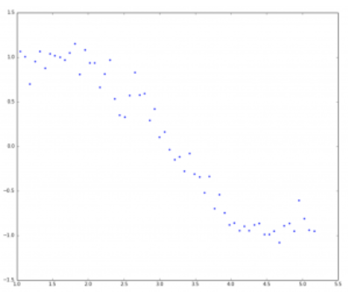

Slide 13
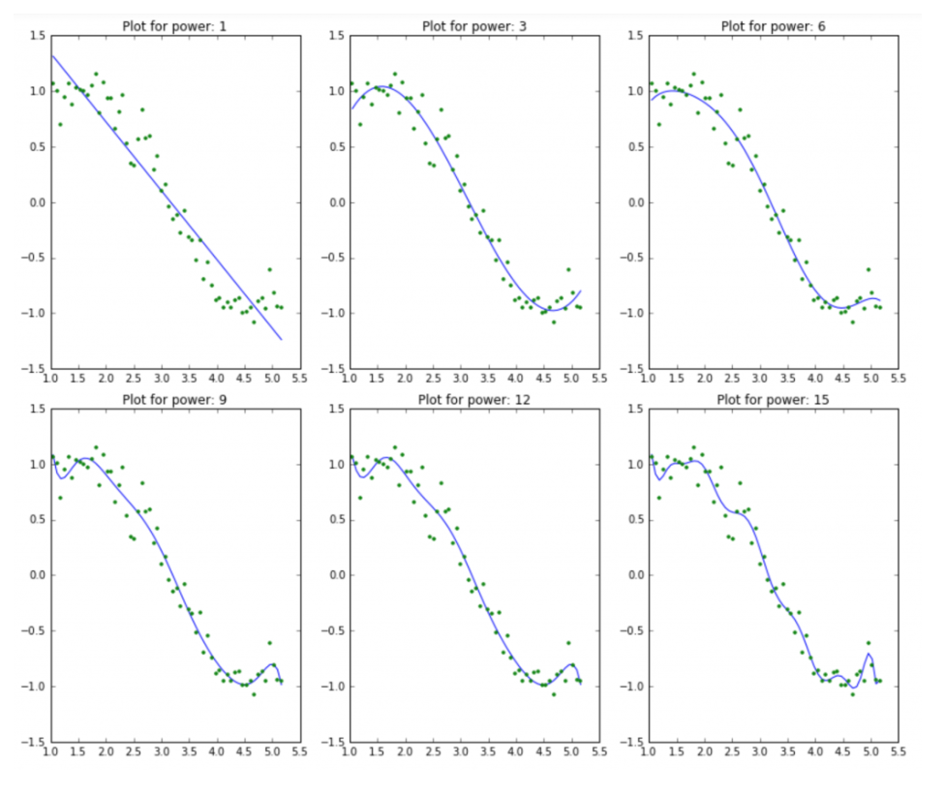

Slide 14
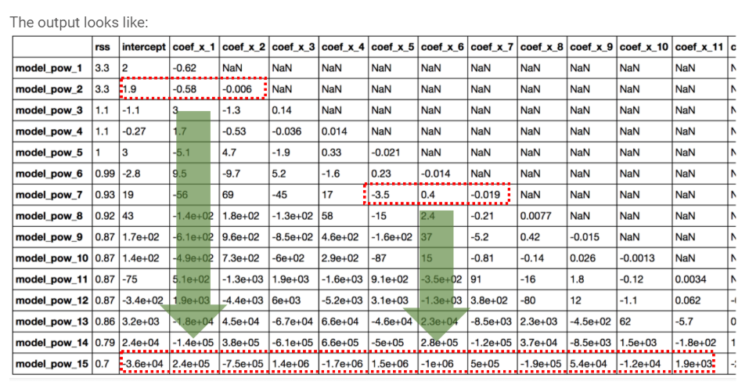

Slide 15
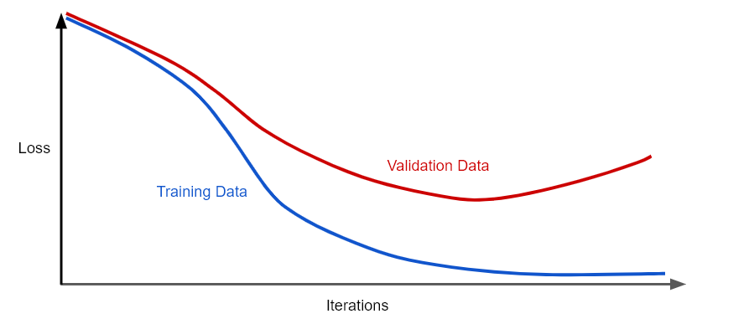
we could prevent overfitting by penalizing complex models, a principle called regularization

Slide 16
RIDGE REGRESSION

Slide 17
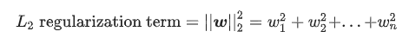
Model complexity as a function of the weights of all the features in the model.
Model complexity as a function of the total number of features with nonzero weights.

Slide 18
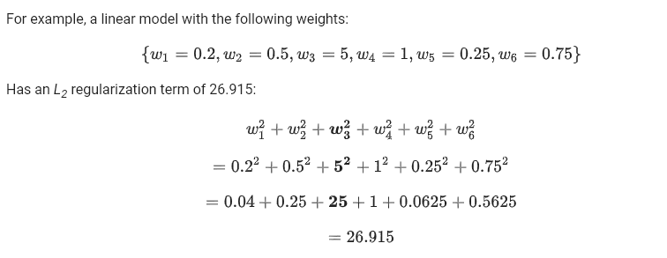

Slide 19
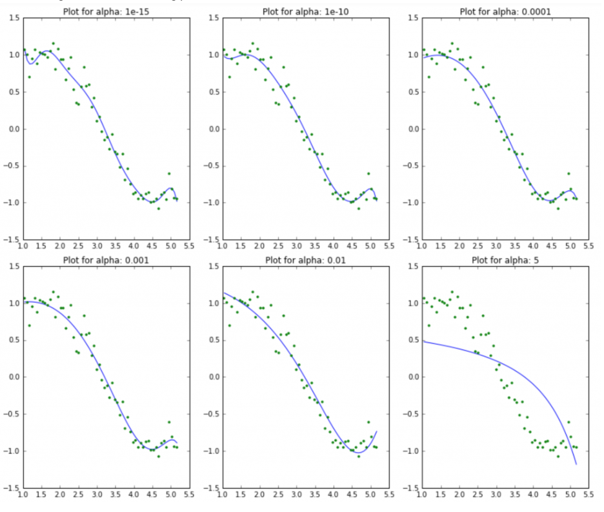

Slide 20
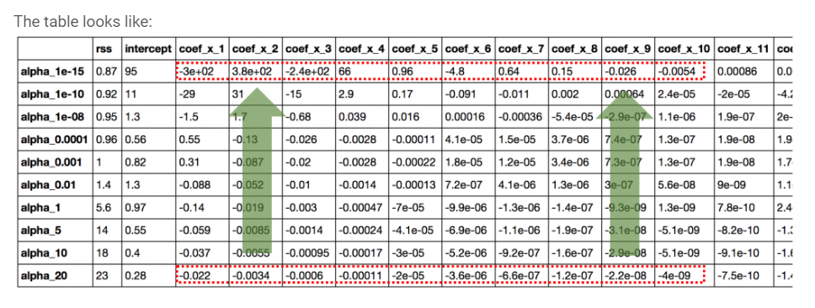

Slide 21
Model developers tune the overall impact of the regularization term by multiplying its value by a scalar known as lambda (also called the regularization rate)
Performing L₂ regularization has the following effect on a model :
Encourages weight values toward 0 (but not exactly 0)
Encourages the mean of the weights toward 0, with a normal (bell-shaped or Gaussian) distribution.

Slide 22
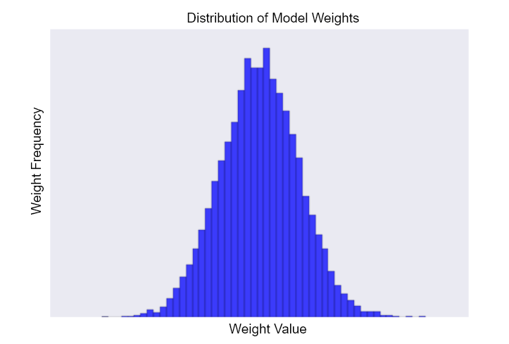
Histogram of weights for a high value of lambda

Slide 23
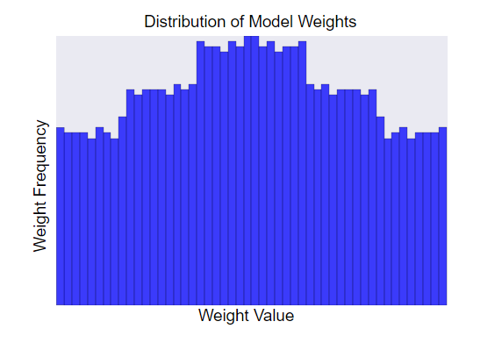
Histogram of weights for a lower value of lambda

Slide 24
L1 Regularization

Slide 25
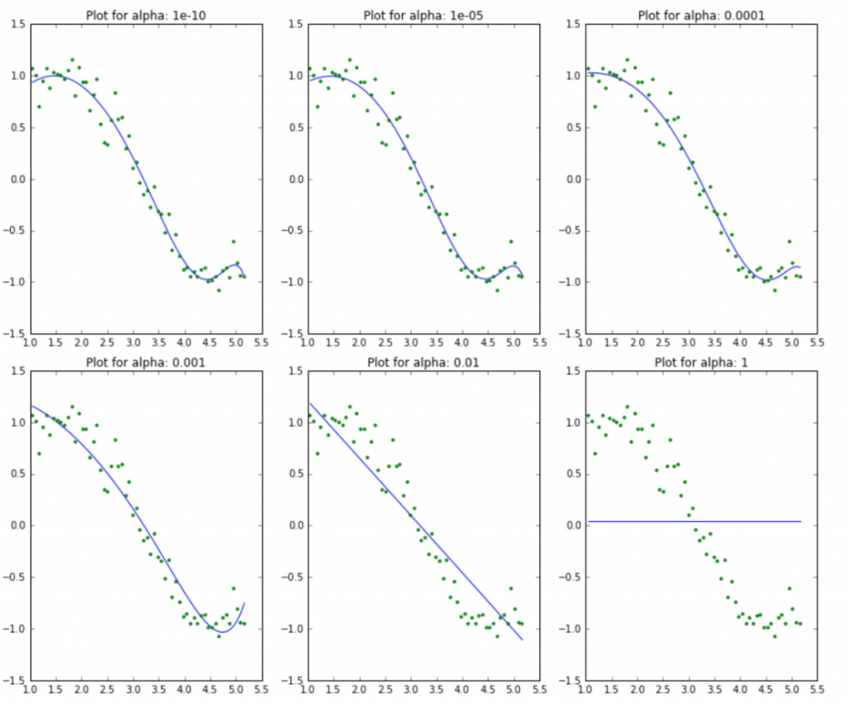

Slide 26
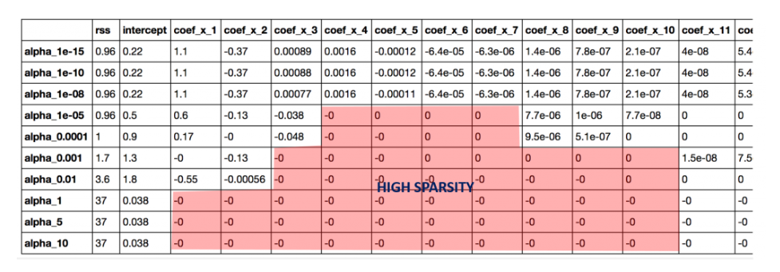

Slide 27
LASSO
For the same values of Alpha, the coefficients of lasso are much smaller as compared to that of ridge
For same Alpha, lasso has higher RSS as compared to ridge
Many of the coefficients are zero for very small values of alpha

Slide 28
L1 Regularisation penalises the absolute weights and encourage uninformative coefficients in the model to be exactly zero

Slide 29
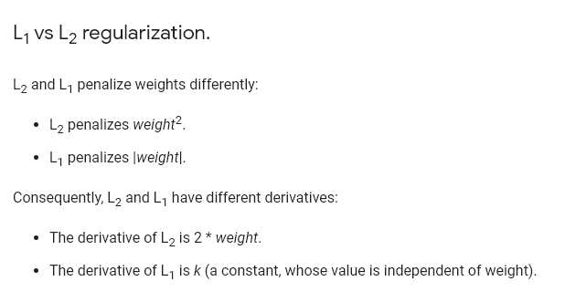
The derivative of L₂ removes x% of the weight every time and does not normally drive weights towards zero
The derivative of L₁ subtracts some constant from the weight every time and encourages the uninformative weights towards zero.

Slide 30
elasticnet

Slide 31
Lasso works best when the model contains a lot of useless variables

Slide 32
Ridge works best when most of the variables in the model are useful

Slide 33
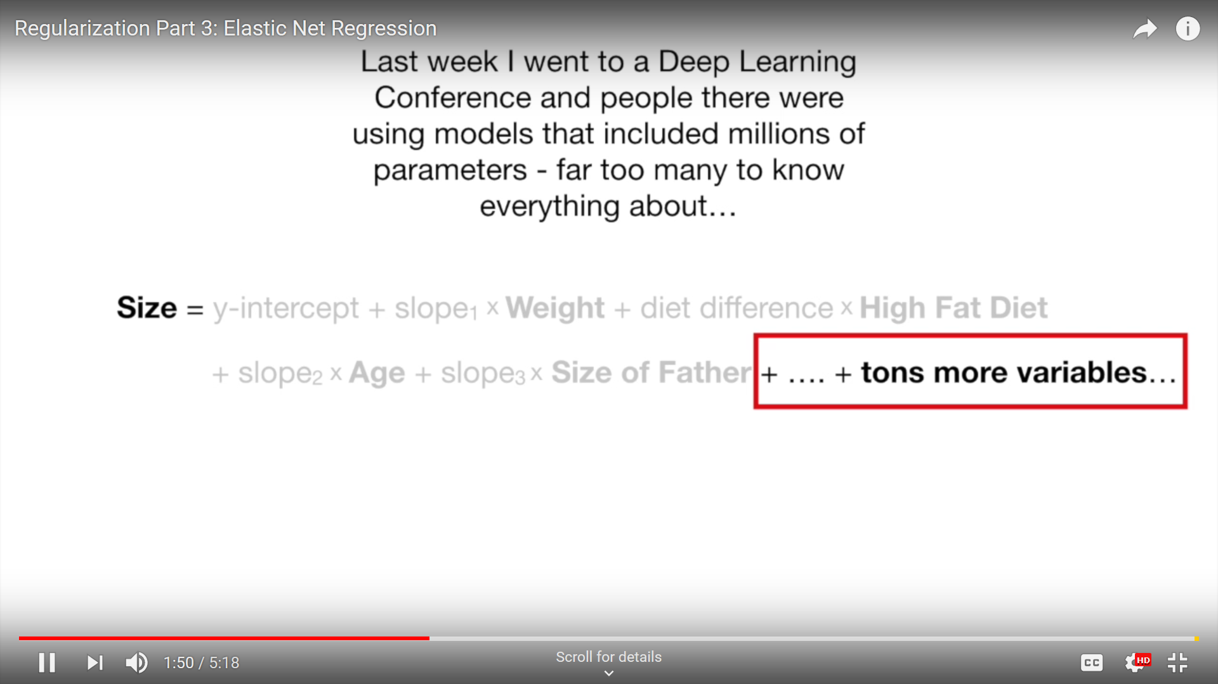

Slide 34
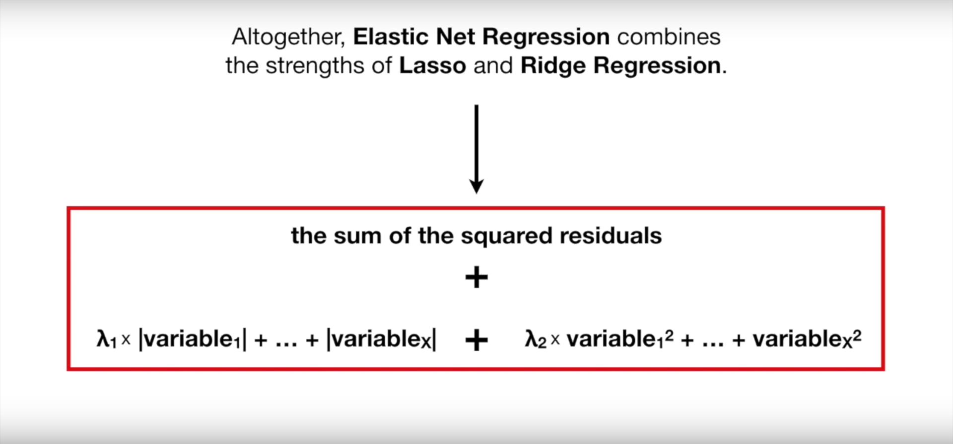

Slide 35
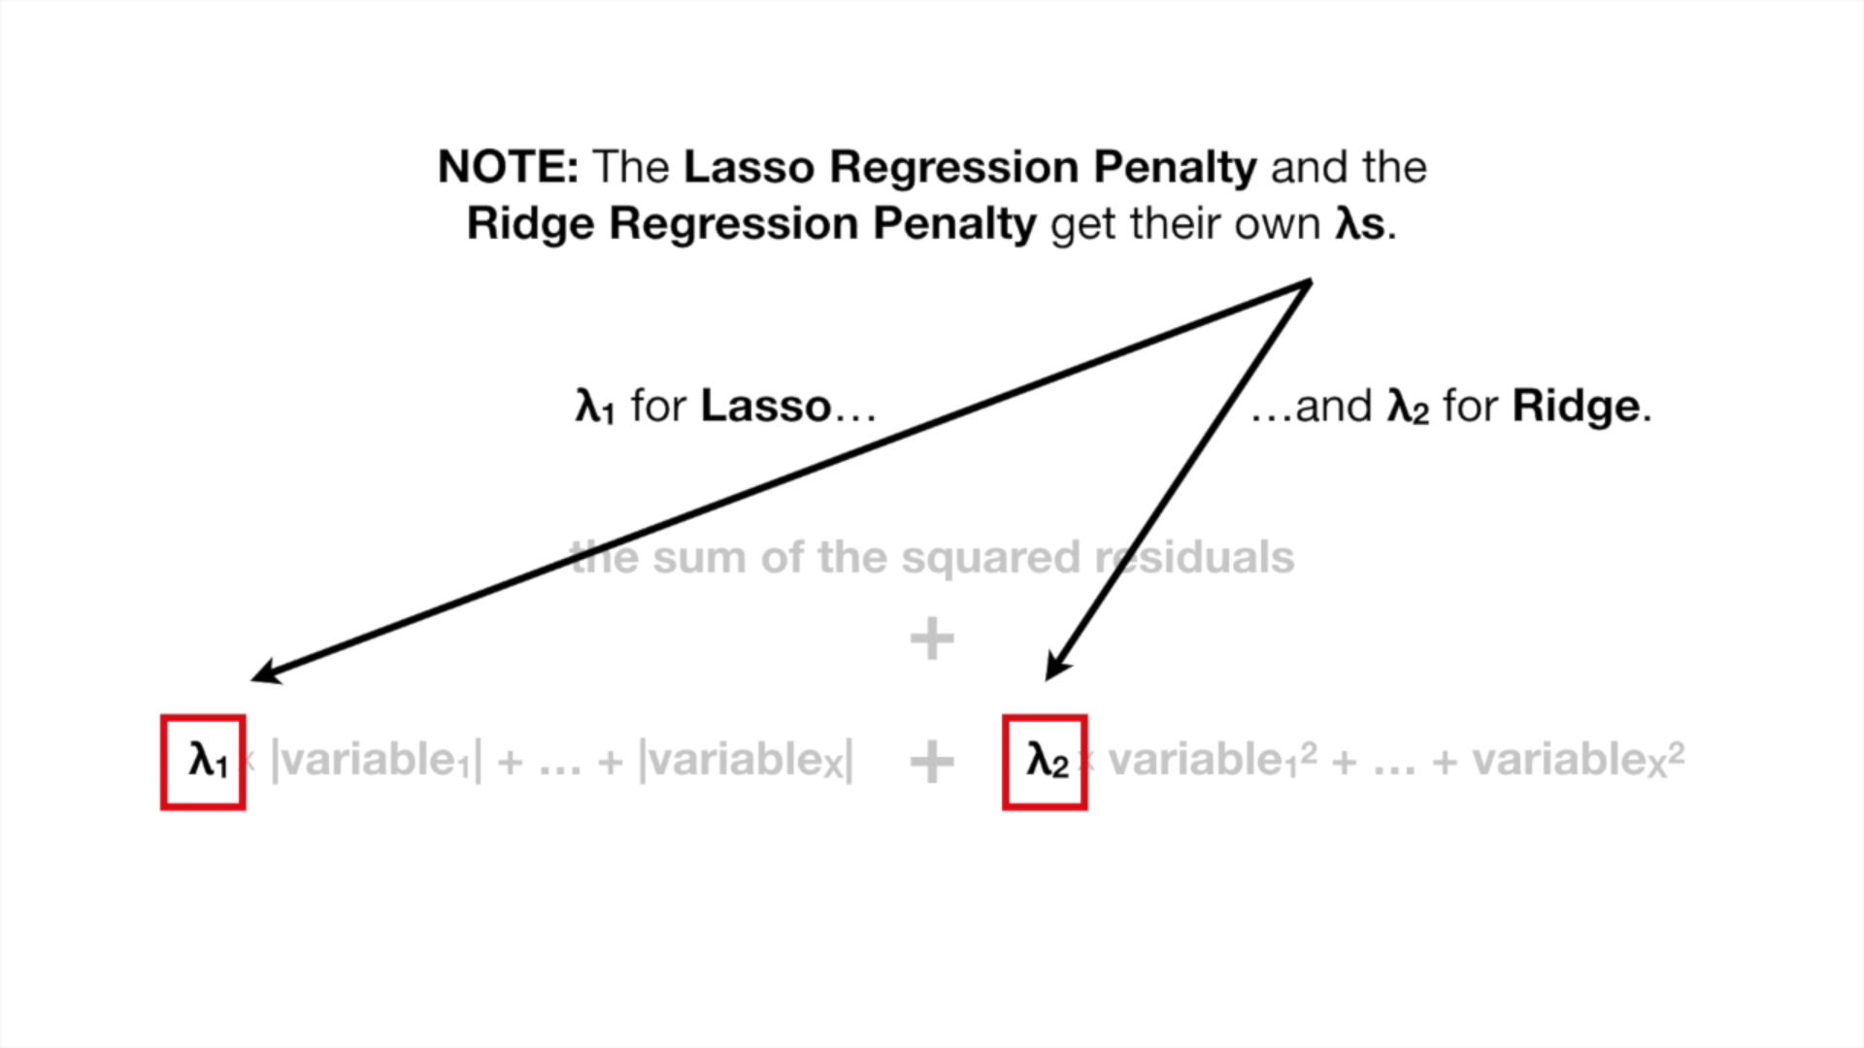

Slide 36
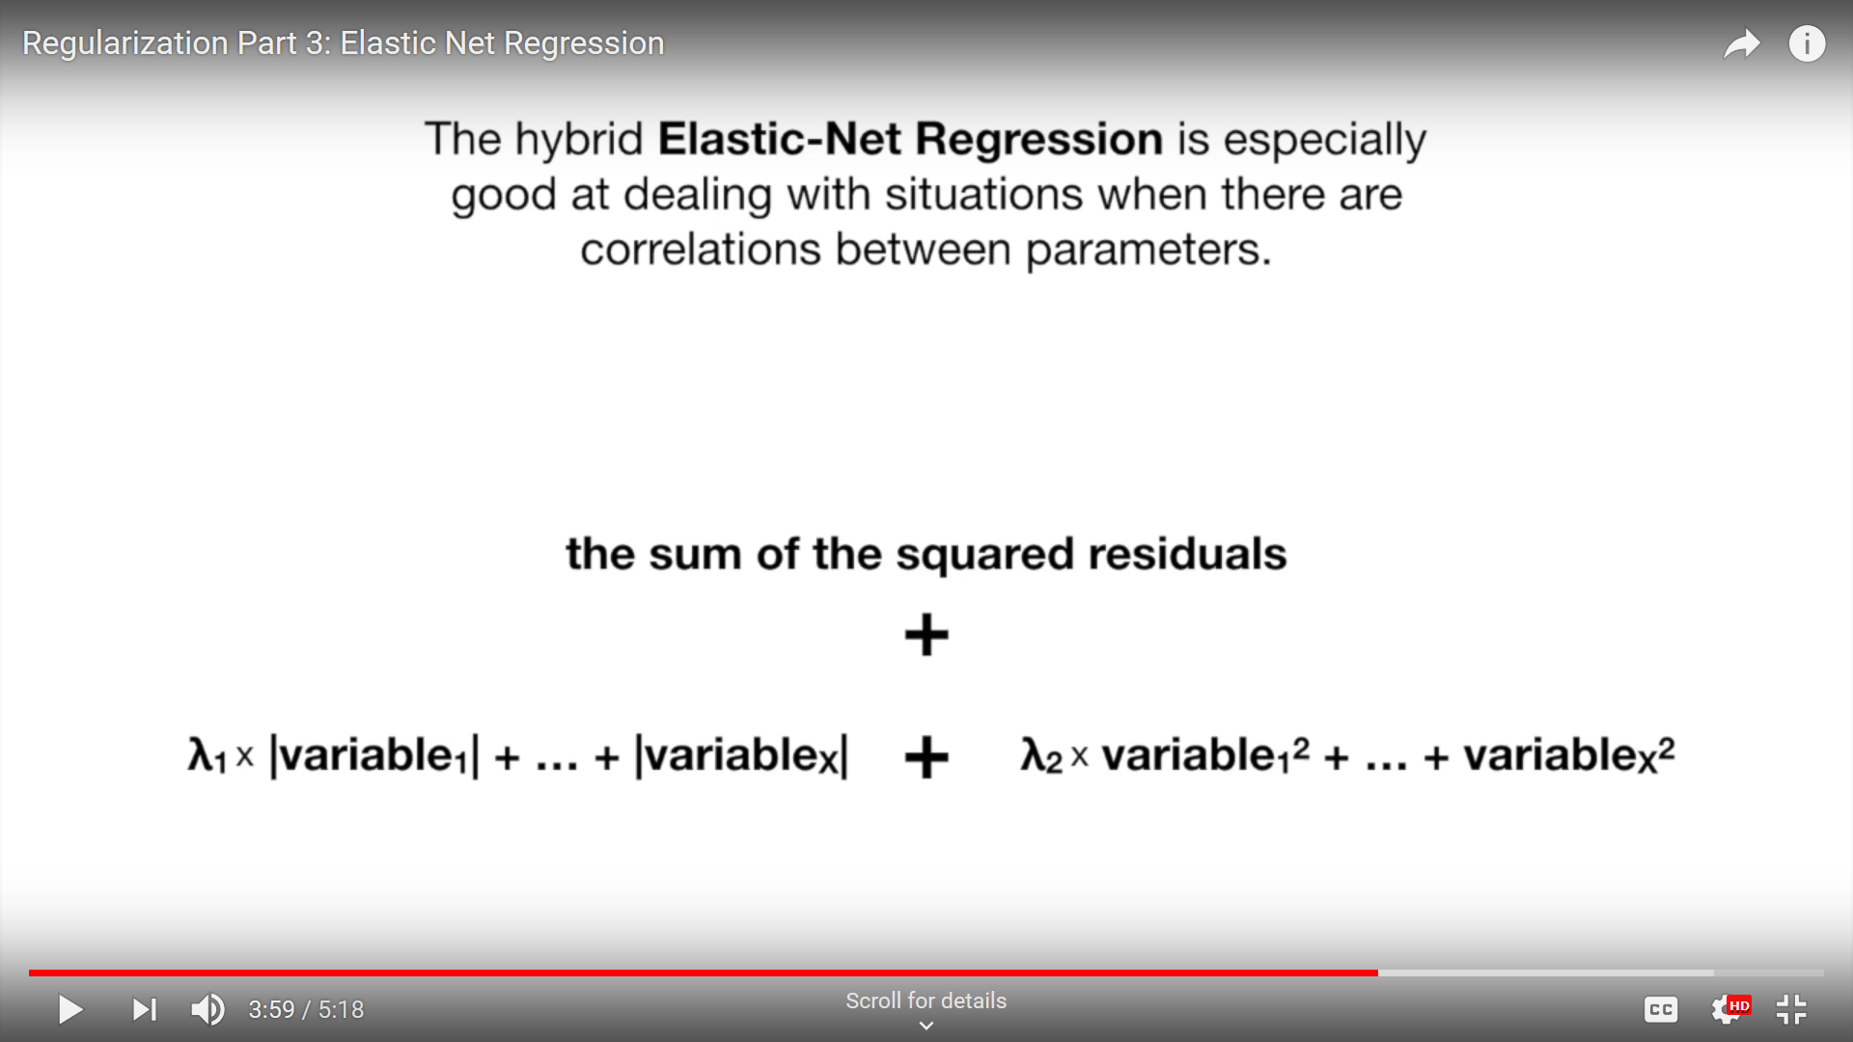

Slide 37
Lasso tends to pick just one of the correlated terms and eliminates the others

Slide 38
Ridge shrinks all of the parameters for the correlated variables together

Slide 39
Elastic-Net groups and shrinks the parameters associated with the correlated variables and leaves them in equation or removes them all at once

Slide 40
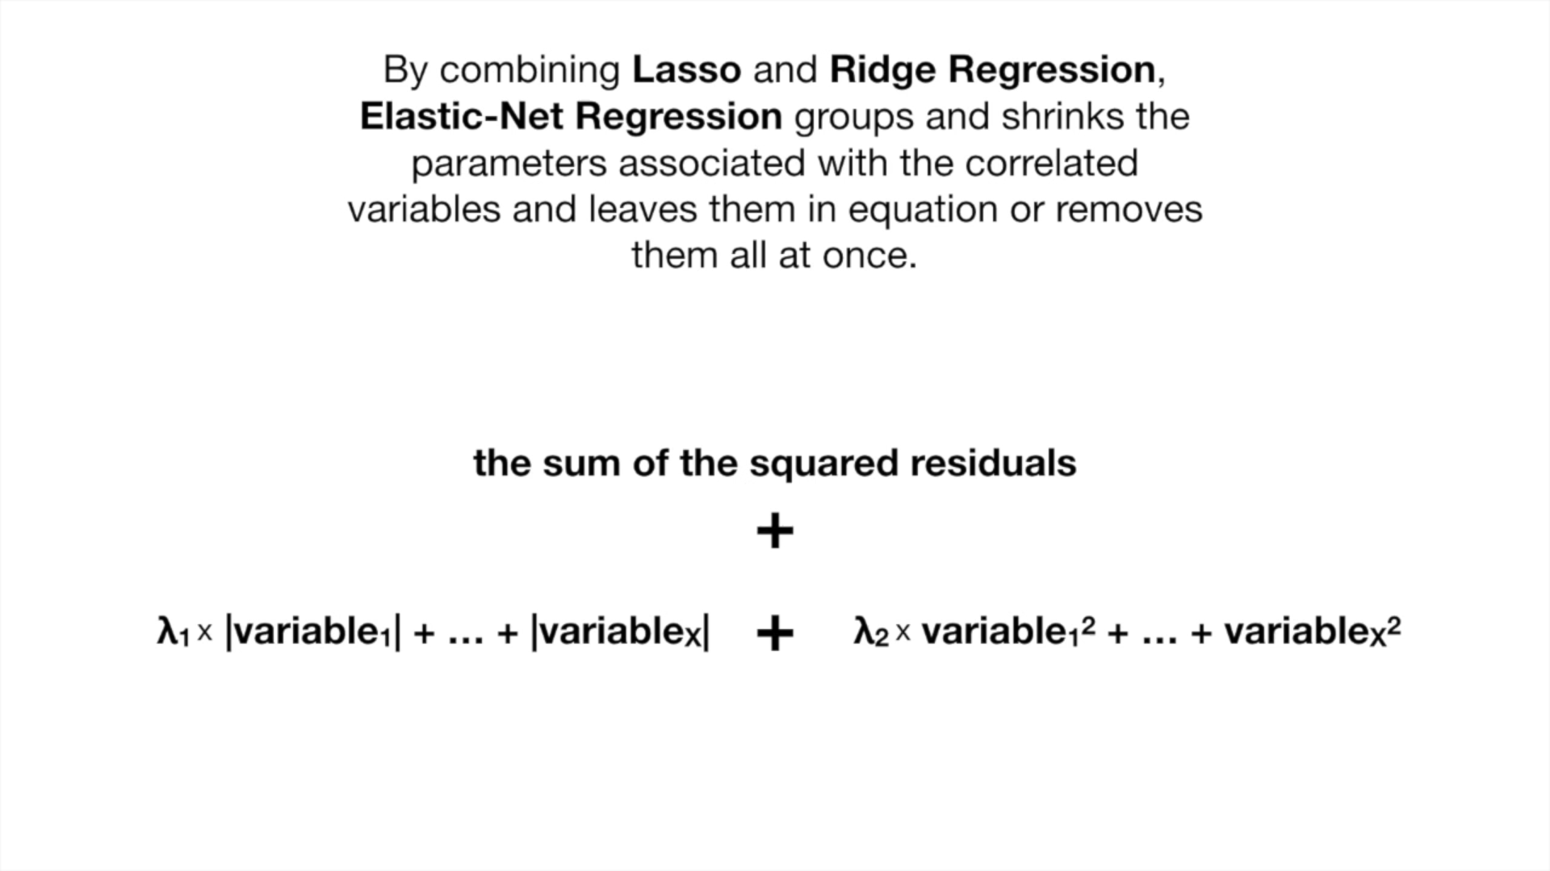
Python Implementation: sklearn.linear_model.ElasticNet

Slide 41
Robust regression

Slide 42
Leverage & Influence
Outliers
Influence
Data with outliers
No errors in data

Slide 43
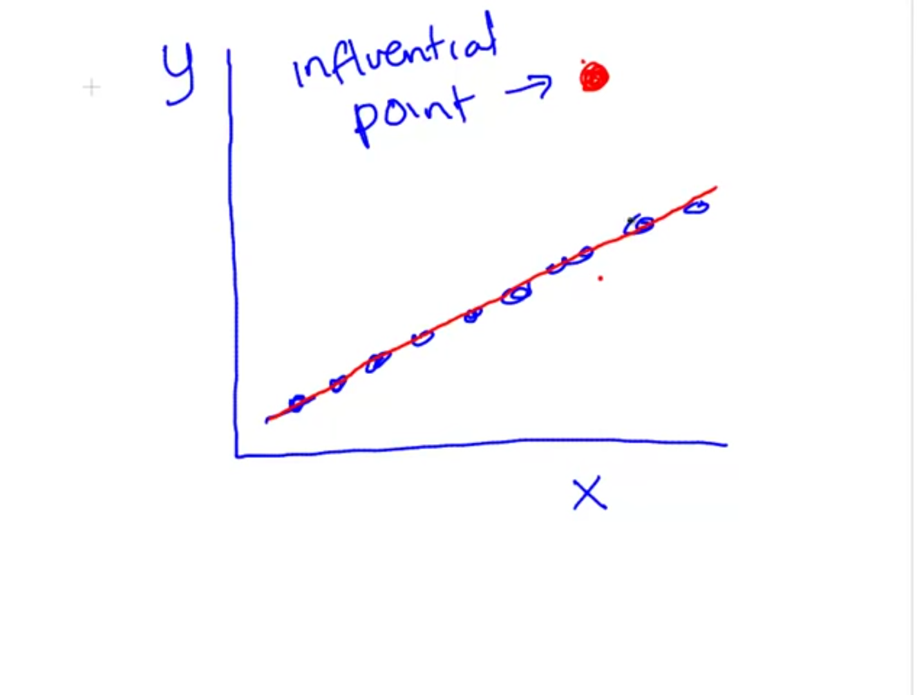
Without outlier

Slide 44
ROBUST REGRESSION
Weigh the observations differently
Outliers are down weighted
Huber weighting – Tuning constant K (calculated from the variance of residuals)

Slide 45
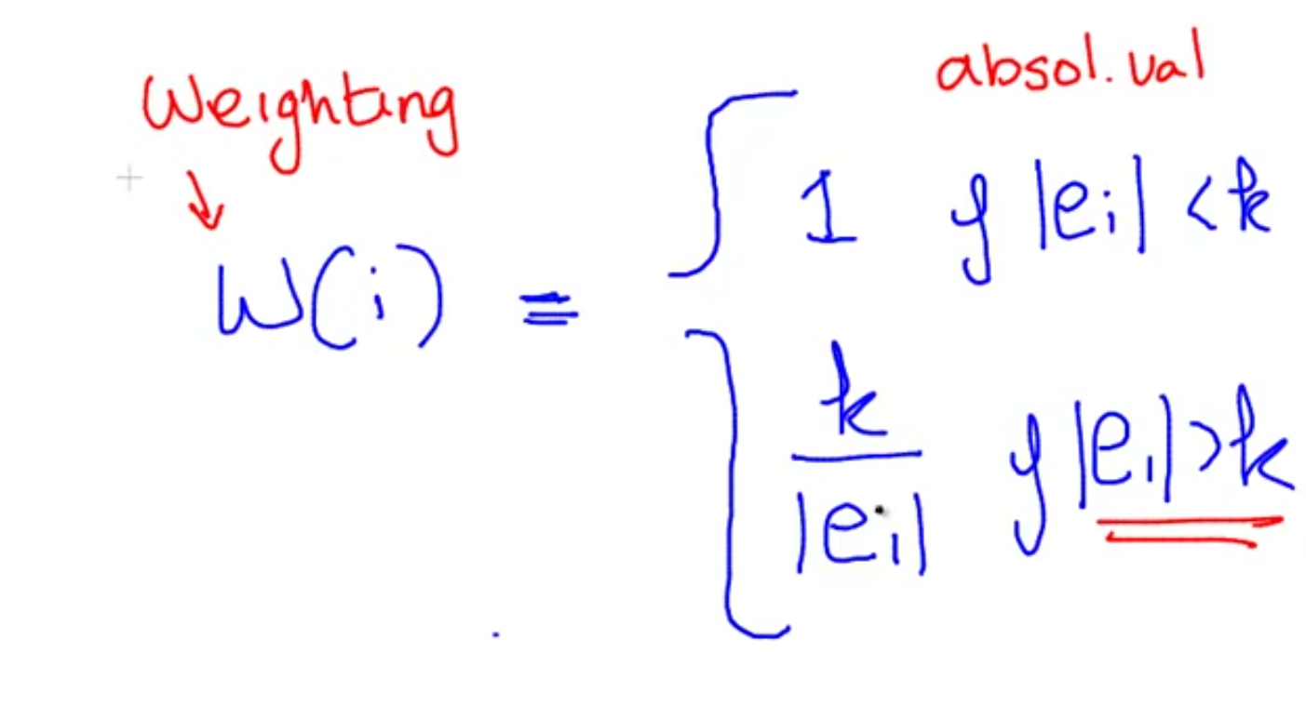
Calculating Weights

Slide 46
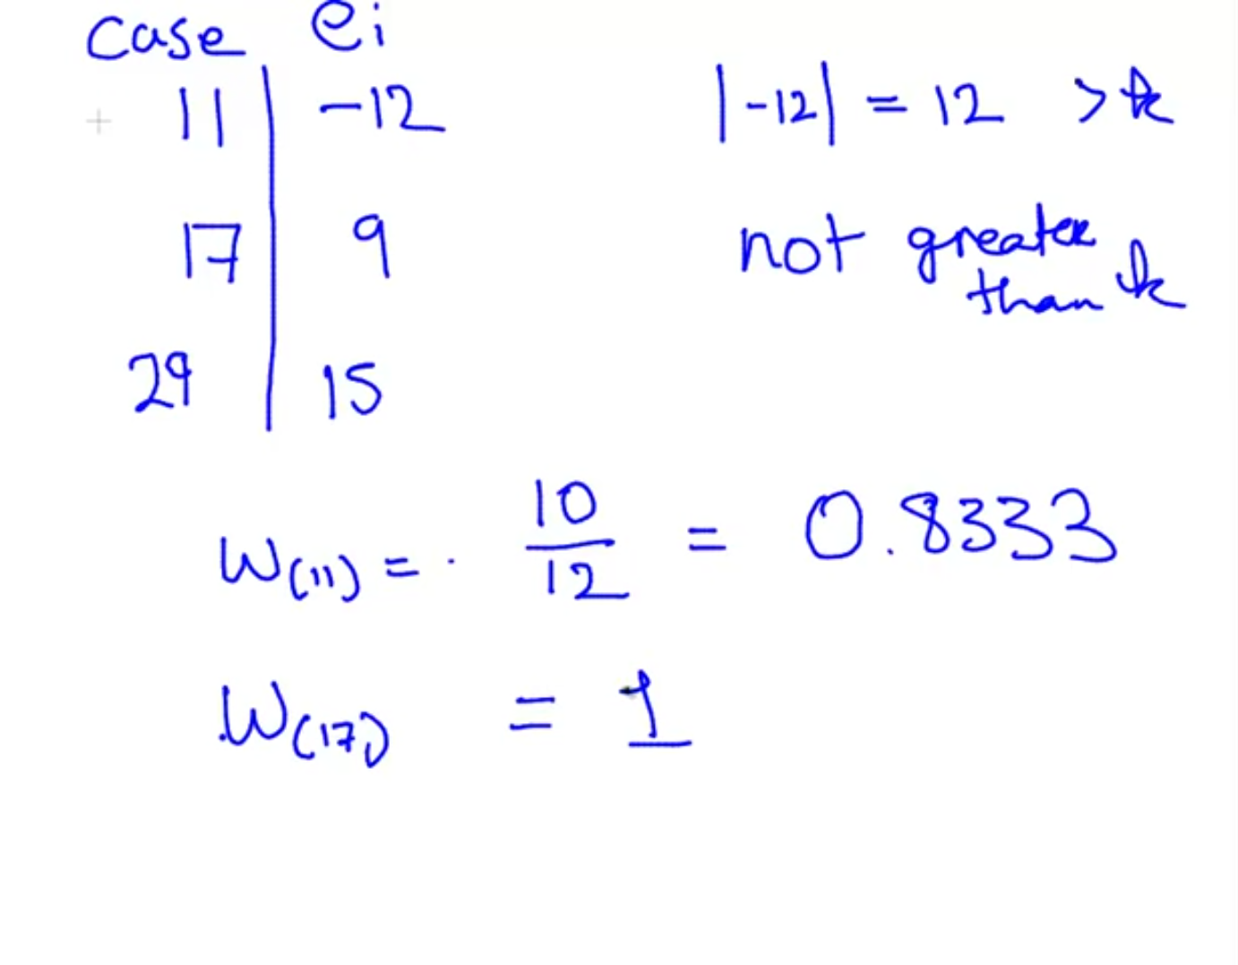
Examples

Slide 47
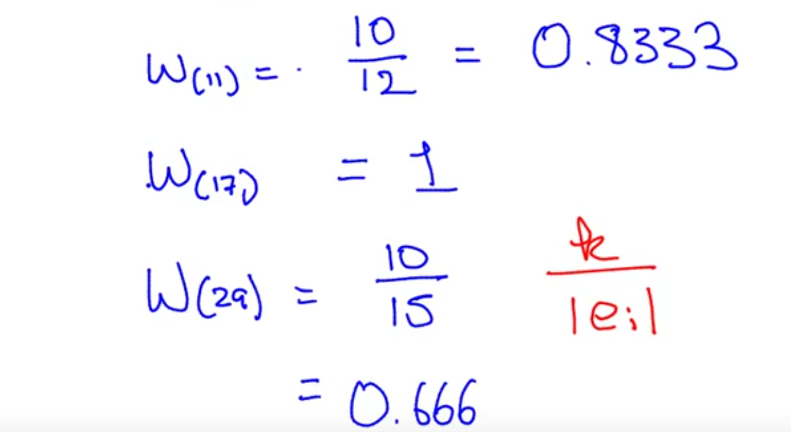
Smaller residuals have more weight than larger residuals
Python Implementation: sklearn.linear_model.HuberRegressor

Slide 48
Demo of Ridge & Lasso regression

Slide 49
Summary
Why Regularization
L1 and L2 Regularization
Demo of Advanced regression
Conclusion
ElasticNet

Slide 50
References
Google Machine Learning course
Analytics Vidhya

Slide 51
#LifeKoKaroLift
Thank You!

